Slide 1

Exit Velocity Methods Comparison
Spencer Marinac and Alex Britton
ME 313
ERAU - SPR 2023

Slide 2
Problem Statement
Baseball players, coaches, and scouts rely on accurate measurements of a player's batted ball exit velocity to assess their skills. Current systems utilize a radar to rest exit velocity. However, we propose developing a system that utilizes an Inertial Measurement Unit (IMU) attached to the bat to track exit ball velocity. The system will accurately measure exit-velocity of a ball and compare to a radar reading of the same measurement.

Slide 3
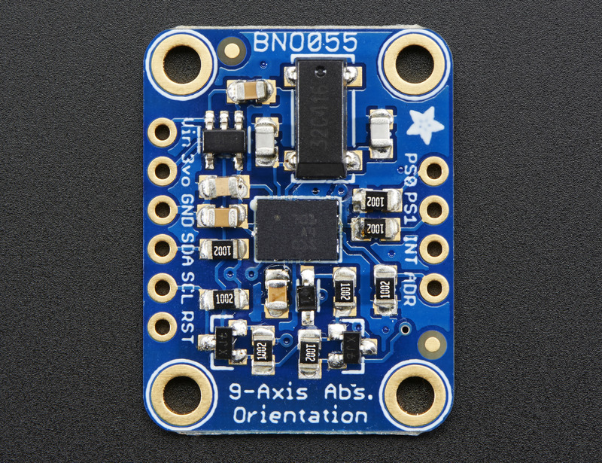
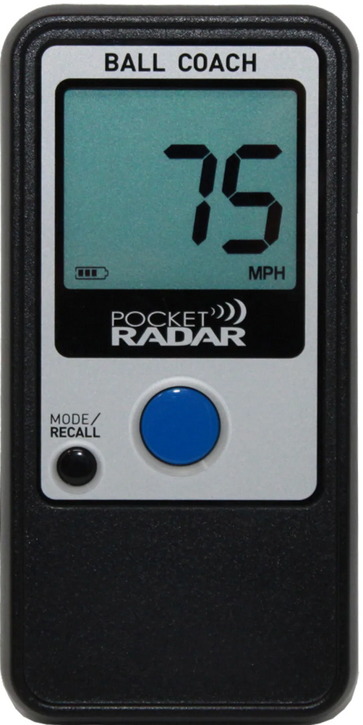
Sensor Summary
BNO005 IMU (Inertial Measurement Unit)
Measures and reports specific force, angular speeds/accelerations, and spatial orientation
Sampling Rate: 100 Hz
Communication Type: I2C
Radar
Measures and reports velocity of object
Sampling Rate: 240 Hz
Communication Type: Bluetooth

Slide 4
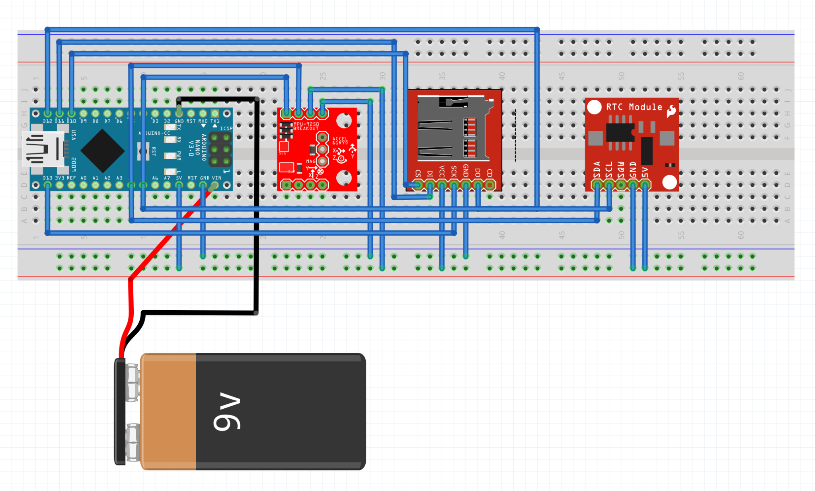
Circuit Schematic

Slide 5
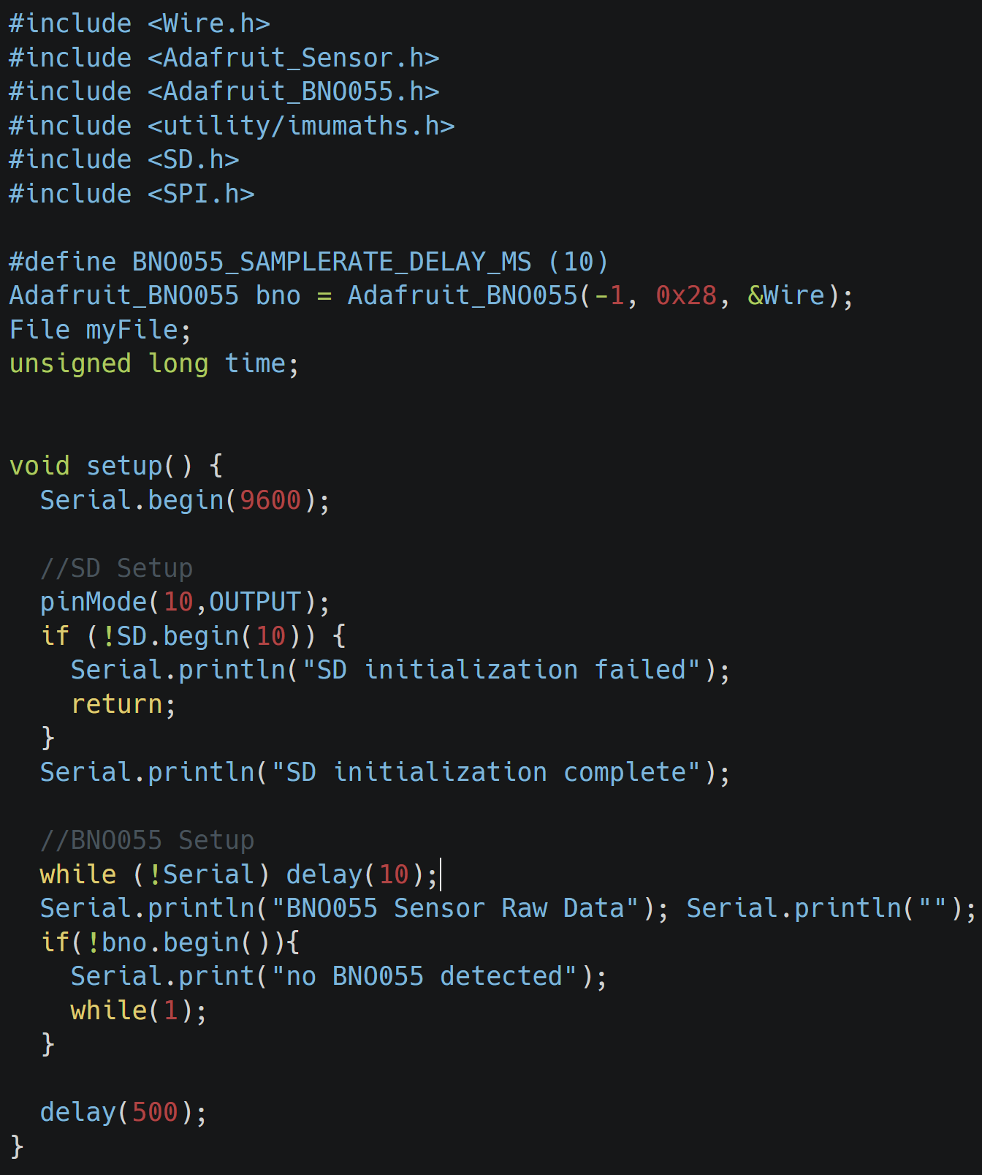
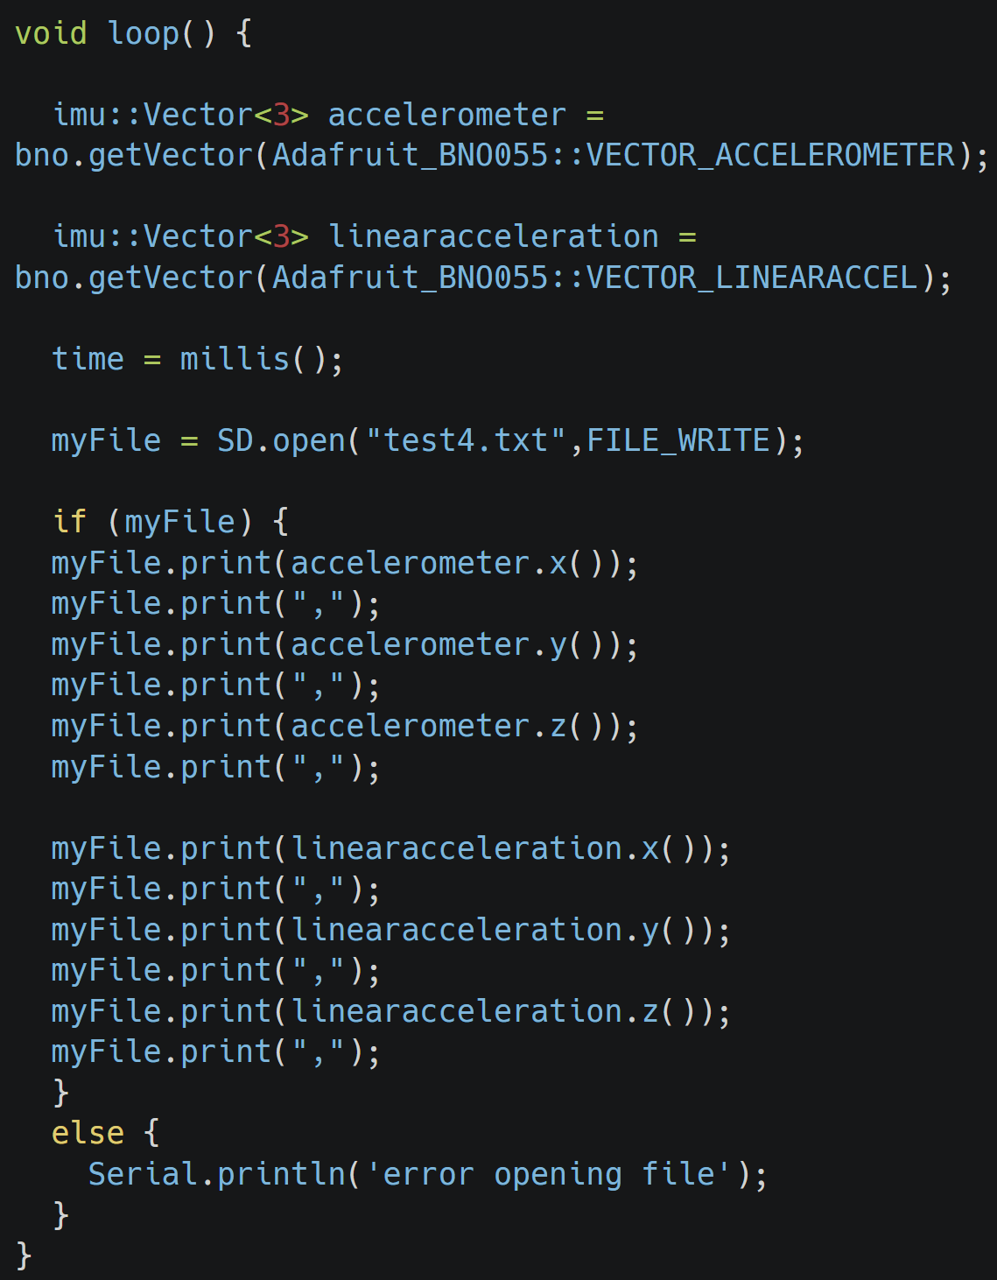
Arduino Code

Slide 6
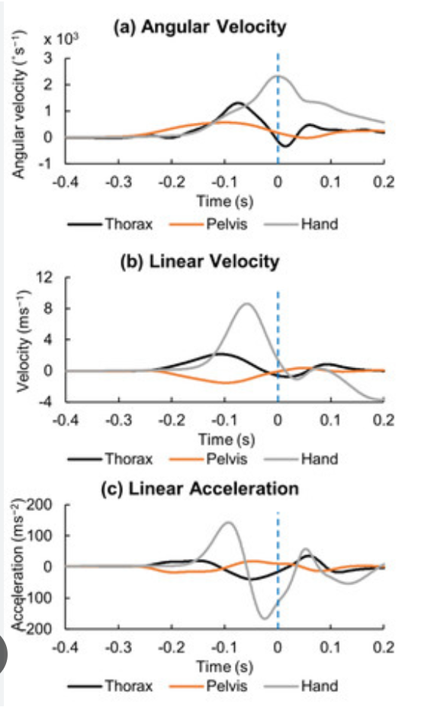
Data Plan
Data Collection:
Collect linear acceleration data versus time during one swing using the IMU
Collect exit velocity data after ball is hit using the radar
Store Data using SD
Data Analysis:
Separate the motion into pre-impact and post-impact/identify impact
Generate graph with Excel for acceleration + integrate for velocity
Calculate exit velocity of ball using conservation of momentum and compare to radar value

Slide 7
Questions?

